Slide 1
Lecture 22
Data Compression-LZW

Slide 2
Huffman Encoding
Statistical encoding
To determine Huffman code, it is useful to construct a binary tree
Leaves are characters to be encoded
Nodes carry occurrence probabilities of the characters belonging to the sub-tree
Notes:
Depends on occurrence frequency of single characters or sequences of data bytes
Characters are stored with their probabilities
Length (number of bits) of the coded characters differs
The shortest code is assigned to the most frequently occurred character
‹#›

Slide 3
Huffman Encoding (Example)
Step 1 : Sort all Symbols according to their probabilities
(left to right) from Smallest to largest
these are the leaves of the Huffman tree
P(B) = 0.51
P(C) = 0.09
P(E) = 0.11
P(D) = 0.13
P(A)=0.16
Notes:
‹#›

Slide 4
Huffman Encoding (Example)
Step 2: Build a binary tree from left to
Right
Policy: always connect two smaller nodes
together (e.g., P(CE) and P(DA) had both
Probabilities that were smaller than P(B),
Hence those two did connect first
P(CEDAB) = 1
P(CEDA) = 0.49
P(B) = 0.51
P(CE) = 0.20
P(DA) = 0.29
P(C) = 0.09
P(E) = 0.11
P(D) = 0.13
P(A)=0.16
Notes:
‹#›

Slide 5
Huffman Encoding (Example)
Step 3: label left branches of the tree
With 0 and right branches of the tree
With 1
P(CEDAB) = 1
0
1
P(CEDA) = 0.49
P(B) = 0.51
0
1
P(CE) = 0.20
P(DA) = 0.29
0
1
0
1
P(C) = 0.09
P(E) = 0.11
P(D) = 0.13
P(A)=0.16
Notes:
‹#›

Slide 6
Huffman Encoding (Example)
Step 4: Create Huffman Code
Symbol A = 011
Symbol B = 1
Symbol C = 000
Symbol D = 010
Symbol E = 001
P(CEDAB) = 1
0
1
P(CEDA) = 0.49
P(B) = 0.51
0
1
P(CE) = 0.20
P(DA) = 0.29
0
1
0
1
P(C) = 0.09
P(E) = 0.11
P(D) = 0.13
P(A)=0.16
Notes:
‹#›

Slide 7

Huffman Decoding
Assume Huffman Table
Symbol Code
X 0
Y 10
Z 11
Consider encoded bitstream: 000101011001110
What is the decoded string?
Notes:
‹#›

Slide 8
Huffman Example
Construct the Huffman coding tree (in class)
Symbol (S) | P(S)
A | 0.25
B | 0.30
C | 0.12
D | 0.15
E | 0.18
Notes:
ORCHID Research Group
Department of Computer Science, University of Illinois at Urbana-Champaign
‹#›

Slide 9
Characteristics of Solution
Symbol (S) | Code
A | 01
B | 11
C | 100
D | 101
E | 00
Notes:
ORCHID Research Group
Department of Computer Science, University of Illinois at Urbana-Champaign
‹#›

Slide 10
Example Encoding/Decoding
Encode “BEAD”
110001101
Decode “0101100”
Symbol (S) | Code
A | 01
B | 11
C | 100
D | 101
E | 00
Notes:
ORCHID Research Group
Department of Computer Science, University of Illinois at Urbana-Champaign
‹#›

Slide 11
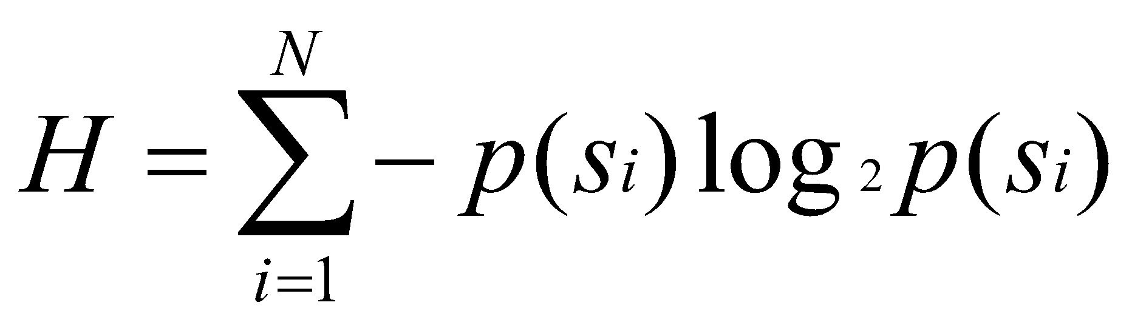
Entropy (Theoretical Limit)
= -.25 * log₂ .25 + -.30 * log₂ .30 + -.12 * log₂ .12 + -.15 * log₂ .15 + -.18 * log₂ .18
H = 2.24 bits
Symbol | P(S) | Code
A | 0.25 | 01
B | 0.30 | 11
C | 0.12 | 100
D | 0.15 | 101
E | 0.18 | 00
Md. Manowarul Islam, Dept. of CSE JnU
Notes:
ORCHID Research Group
Department of Computer Science, University of Illinois at Urbana-Champaign
‹#›

Slide 12
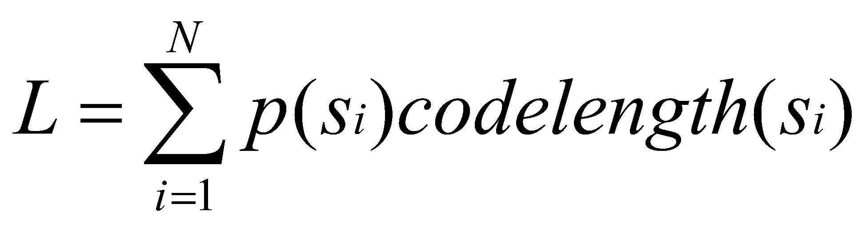
Average Codeword Length
= .25(2) + .30(2) + .12(3) + .15(3) + .18(2)
L = 2.27 bits
Symbol | P(S) | Code
A | 0.25 | 01
B | 0.30 | 11
C | 0.12 | 100
D | 0.15 | 101
E | 0.18 | 00
Md. Manowarul Islam, Dept. of CSE JnU
Notes:
ORCHID Research Group
Department of Computer Science, University of Illinois at Urbana-Champaign
‹#›

Slide 13
Example
H = -.01*log₂.01 + -.99*log₂.99
= .08
L = .01(1) + .99(1)
= 1
Symbol | P(S) | Code
A | 0.01 | 1
B | 0.99 | 0
Notes:
ORCHID Research Group
Department of Computer Science, University of Illinois at Urbana-Champaign
‹#›

Slide 14
Group Exercise
Compute Entropy (H)
Build Huffman tree
Compute average code length
Code “BCCADE”
Symbol (S) | P(S)
A | 0.1
B | 0.2
C | 0.4
D | 0.2
E | 0.1
Notes:
ORCHID Research Group
Department of Computer Science, University of Illinois at Urbana-Champaign
‹#›

Slide 15
Dictionary-based Coding
LZW (Lempel–Ziv–Welch) uses fixed-length codeword to represent variable-length strings of symbols/characters that commonly occur together, e.g., words in English text.
The LZW encoder and decoder build up the same dictionary dynamically while receiving the data.
LZW places longer and longer repeated entries into a dictionary, and then emits the code for an element, rather than the string itself, if the element has already been placed in the dictionary.

Slide 16
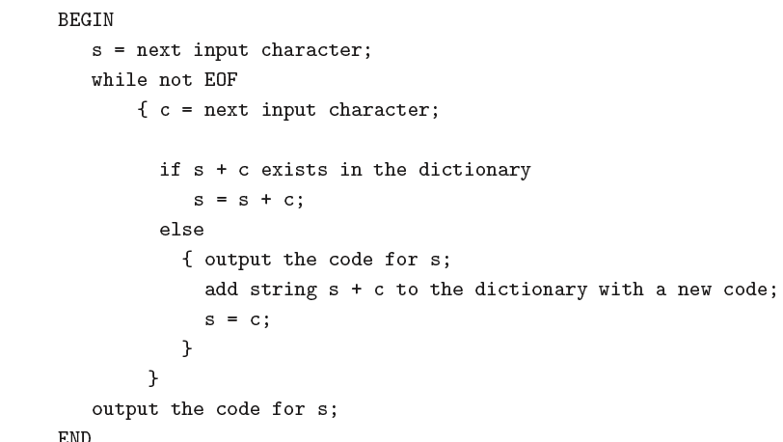
LZW Compression Algorithm

Slide 17
LZW Compression Example
We will compress the string
"ABABBABCABABBA"
Initially the dictionary is the following
Code | String
1 | A
2 | B
2 | C

Slide 18
LZW Example
S | C | Output | Code | string
A | B | 1 | 4 | AB
ABABBABCABABBA
string | code
A | 1
B | 2
C | 3

Slide 19
LZW Example
S | C | Output | Code | string
A | B | 1 | 4 | AB
B | A | 2 | 5 | BA
ABABBABCABABBA
string | code
A | 1
B | 2
C | 3

Slide 20
LZW Example
S | C | Output | Code | string
A | B | 1 | 4 | AB
B | A | 2 | 5 | BA
A | B
ABABBABCABABBA
string | code
A | 1
B | 2
C | 3

Slide 21
LZW Example
S | C | Output | Code | string
A | B | 1 | 4 | AB
B | A | 2 | 5 | BA
A | B
AB | B | 4 | 6 | ABB
ABABBABCABABBA
string | code
A | 1
B | 2
C | 3

Slide 22
LZW Example
S | C | Output | Code | string
A | B | 1 | 4 | AB
B | A | 2 | 5 | BA
A | B
AB | B | 4 | 6 | ABB
B | A
ABABBABCABABBA
string | code
A | 1
B | 2
C | 3

Slide 23
LZW Example
S | C | Output | Code | string
A | B | 1 | 4 | AB
B | A | 2 | 5 | BA
A | B
AB | B | 4 | 6 | ABB
B | A
BA | B | 5 | 7 | BAB
ABABBABCABABBA
string | code
A | 1
B | 2
C | 3

Slide 24
LZW Example
S | C | Output | Code | string
A | B | 1 | 4 | AB
B | A | 2 | 5 | BA
A | B
AB | B | 4 | 6 | ABB
B | A
BA | B | 5 | 7 | BAB
B | C | 2 | 8 | BC
ABABBABCABABBA
string | code
A | 1
B | 2
C | 3

Slide 25
LZW Example
S | C | Output | Code | string
A | B | 1 | 4 | AB
B | A | 2 | 5 | BA
A | B
AB | B | 4 | 6 | ABB
B | A
BA | B | 5 | 7 | BAB
B | C | 2 | 8 | BC
C | A | 3 | 9 | CA
ABABBABCABABBA
string | code
A | 1
B | 2
C | 3

Slide 26
LZW Example
S | C | Output | Code | string
A | B | 1 | 4 | AB
B | A | 2 | 5 | BA
A | B
AB | B | 4 | 6 | ABB
B | A
BA | B | 5 | 7 | BAB
B | C | 2 | 8 | BC
C | A | 3 | 9 | CA
A | B
ABABBABCABABBA
string | code
A | 1
B | 2
C | 3

Slide 27
LZW Example
S | C | Output | Code | string
A | B | 1 | 4 | AB
B | A | 2 | 5 | BA
A | B
AB | B | 4 | 6 | ABB
B | A
BA | B | 5 | 7 | BAB
B | C | 2 | 8 | BC
C | A | 3 | 9 | CA
A | B
AB | A | 4 | 10 | ABA
ABABBABCABABBA
string | code
A | 1
B | 2
C | 3

Slide 28
LZW Example
S | C | Output | Code | string
A | B | 1 | 4 | AB
B | A | 2 | 5 | BA
A | B
AB | B | 4 | 6 | ABB
B | A
BA | B | 5 | 7 | BAB
B | C | 2 | 8 | BC
C | A | 3 | 9 | CA
A | B
AB | A | 4 | 10 | ABA
A | B
ABABBABCABABBA
string | code
A | 1
B | 2
C | 3

Slide 29
LZW Example
S | C | Output | Code | string
A | B | 1 | 4 | AB
B | A | 2 | 5 | BA
A | B
AB | B | 4 | 6 | ABB
B | A
BA | B | 5 | 7 | BAB
B | C | 2 | 8 | BC
C | A | 3 | 9 | CA
A | B
AB | A | 4 | 10 | ABA
A | B
AB | B
ABABBABCABABBA
string | code
A | 1
B | 2
C | 3

Slide 30
LZW Example
S | C | Output | Code | string
A | B | 1 | 4 | AB
B | A | 2 | 5 | BA
A | B
AB | B | 4 | 6 | ABB
B | A
BA | B | 5 | 7 | BAB
B | C | 2 | 8 | BC
C | A | 3 | 9 | CA
A | B
AB | A | 4 | 10 | ABA
A | B
AB | B
ABB | A | 6 | 11 | ABBA
ABABBABCABABBA
string | code
A | 1
B | 2
C | 3

Slide 31
LZW Example
S | C | Output | Code | string
A | B | 1 | 4 | AB
B | A | 2 | 5 | BA
A | B
AB | B | 4 | 6 | ABB
B | A
BA | B | 5 | 7 | BAB
B | C | 2 | 8 | BC
C | A | 3 | 9 | CA
A | B
AB | A | 4 | 10 | ABA
A | B
AB | B
ABB | A | 6 | 11 | ABBA
A | EOF | 1
ABABBABCABABBA
string | code
A | 1
B | 2
C | 3

Slide 32
LZW Example
We will compress the string
"ABABBABCABABBA "
124523461
The output codes are: 1 2 4 5 2 3 4 6 1. Instead of sending 14 characters, only 9 codes need to be sent
compression ratio = 14/9 = 1.56

Slide 33
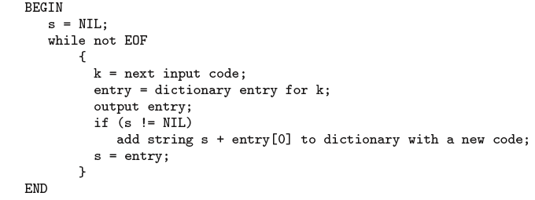
LZW Decompression

Slide 34
LZW Decompression Example
We will decompress the string
"124523461"
Initially the dictionary is the following
Code | String
1 | A
2 | B
3 | C

Slide 35
LZW Example
S | k | Output/entry | Code | string
NIL | 1 | A
124523461
string | code
A | 1
B | 2
C | 3

Slide 36
LZW Example
S | k | Output/entry | Code | string
NIL | 1 | A
A | 2 | B | 4 | AB
124523461
string | code
A | 1
B | 2
C | 3

Slide 37
LZW Example
S | k | Output/entry | Code | string
NIL | 1 | A
A | 2 | B | 4 | AB
B | 4 | AB | 5 | BA
124523461
string | code
A | 1
B | 2
C | 3

Slide 38
LZW Example
S | k | Output/entry | Code | string
NIL | 1 | A
A | 2 | B | 4 | AB
B | 4 | AB | 5 | BA
AB | 5 | BA | 6 | ABB
124523461
string | code
A | 1
B | 2
C | 3

Slide 39
LZW Example
S | k | Output/entry | Code | string
NIL | 1 | A
A | 2 | B | 4 | AB
B | 4 | AB | 5 | BA
AB | 5 | BA | 6 | ABB
BA | 2 | B | 7 | BAB
124523461
string | code
A | 1
B | 2
C | 3

Slide 40
LZW Example
S | k | Output/entry | Code | string
NIL | 1 | A
A | 2 | B | 4 | AB
B | 4 | AB | 5 | BA
AB | 5 | BA | 6 | ABB
BA | 2 | B | 7 | BAB
B | 3 | C | 8 | BC
124523461
string | code
A | 1
B | 2
C | 3

Slide 41
LZW Example
S | k | Output/entry | Code | string
NIL | 1 | A
A | 2 | B | 4 | AB
B | 4 | AB | 5 | BA
AB | 5 | BA | 6 | ABB
BA | 2 | B | 7 | BAB
B | 3 | C | 8 | BC
C | 4 | AB | 9 | CA
124523461
string | code
A | 1
B | 2
C | 3

Slide 42
LZW Example
S | k | Output/entry | Code | string
NIL | 1 | A
A | 2 | B | 4 | AB
B | 4 | AB | 5 | BA
AB | 5 | BA | 6 | ABB
BA | 2 | B | 7 | BAB
B | 3 | C | 8 | BC
C | 4 | AB | 9 | CA
AB | 6 | ABB | 10 | ABA
124523461
string | code
A | 1
B | 2
C | 3

Slide 43
LZW Example
S | k | Output/entry | Code | string
NIL | 1 | A
A | 2 | B | 4 | AB
B | 4 | AB | 5 | BA
AB | 5 | BA | 6 | ABB
BA | 2 | B | 7 | BAB
B | 3 | C | 8 | BC
C | 4 | AB | 9 | CA
AB | 6 | ABB | 10 | ABA
ABB | 1 | A | 11 | ABBA
124523461
string | code
A | 1
B | 2
C | 3

Slide 44
LZW Example
S | k | Output/ Entry | Code | string
NIL | 1 | A
A | 2 | B | 4 | AB
B | 4 | AB | 5 | BA
AB | 5 | BA | 6 | ABB
BA | 2 | B | 7 | BAB
B | 3 | C | 8 | BC
C | 4 | AB | 9 | CA
AB | 6 | ABB | 10 | ABA
ABB | 1 | A | 11 | ABBA
A | EOF
124523461
string | code
A | 1
B | 2
C | 3

Slide 45
LZW Compression Example
We will decompress the string
"124523461“
ABABBABCABABBA

Slide 46
Assignment
Use LZW to trace encoding the string
ABRACADABRA.
Write a java program that encodes a given string using LZW.
Write a java program that decodes a given set of encoded codeword using LZW.

Slide 47
END

